Slide 1
TVIs and Technology to Acquire Digital AIM
GITWL Conference Nov 2023
HuyenTran Vo
TVI, CATIS, COMS, CVRT
Ph.D. Candidate- UMass Boston
Notes:
Hello everyone! My first name is Huyentran, and my last name is Vo. I am PhD candidate at UMass Boston. Today I will be presenting on my ongoing dissertation research of Teachers of Students with visual impairments and technology to acquire digital accessible instructional materials.
Image credit: https://64.media.tumblr.com/9c9d6ee21f8d117b5f8e92edbc2c64ed/874e34b948f5fbb8-3b/s540x810/194ba5f41a282bc7b2db6eecf2841f1fe3a4f7e2.gif

Slide 2
Agenda
Key Terminology
Complexity of Digital AIM
Summary of My Study
Sample Survey
Reflect and Share
Questions
Notes:
For my presentation today, I’m going to go over key terminology for my study; describe some of the complexities of acquiring digital aim. Review the theoretical framework that drives my research, go over the summary of the literature review, preview a sample portion of my study, compare results with your own experiences.

Slide 3
Key Terms
Students with visual impairments
Teachers of students with visual impairments (TVI)
Digital Accessible Instructional Materials (AIM)
Acquiring materials
Technology
Notes:
Students with visual impairments are those whose “vision, even with correction, adversely affects a child’s educational performance” Sec. 300.8 (c) (13). This term encompasses K-12 students with visual impairment, blindness, and low vision, including those with additional or severe disabilities.
I will be using the acronym TVI to stand for Teachers of students with visual impairments. These teachers are responsible for assessing and teaching the expanded core curriculum, which are nine specific skill areas students with visual impairments may need due to lack of incidental learning from their visual sense. One area is assistive technology. TVI also help students access to the general core curriculum. TVIs are often one of the leading players responsible for acquiring accessible materials. So they have the role of consulting with teachers and other professionals for access to the core curriculum.
Instructional/ Learning Materials are any items a teacher uses to educate students (i.e., books, worksheets, lab equipment) to assist students in their academic pursuits.
Accessible Format/ Accessible Instructional Materials (AIM) are a preferred usable learning medium, and alternative formats include large print, braille, digital, audio materials, and hybrids.
While AIM can be in various forms, this study will focus on digital AIM. Digital AIM are materials that exist in form requiring the use of technology, including electronic documents, websites, games, and learning management platforms. Braille and other accessible formats remain essential tools in helping students access literacy, regardless of the study's emphasis on digital materials. When students have access to digital AIM, the conversion of digital accessible content into other accessible formats is possible. For example, students can access braille using an electronic refreshable braille display, audio formats using text to computerize speech with screen readers, and large print using screen magnifiers.
Acquisition of AIM encompasses all the steps involved in getting materials from the classroom teacher to the student so that the student can access and use the materials with or without assistive technology.
This study looks into how TVIs use technology which is any tool ranging from low to high tech that TVIs can use to acquire digital materials and includes mainstream and assistive technology.
Mainstream technologies are created for the general public.
Assistive Technology/ Access Technology used interchangeably are “Any item, piece of equipment, or product system that is used to increase, maintain, or improve functional capabilities of a student with a disability

Slide 4
Overarching Question
How are TVIs utilizing technology to acquire digital AIM for K–12 students with visual impairments in the United States?
Notes:
My overarching questions: How are TVIs utilizing technology to acquire digital AIM for K–12 students with visual impairments in the United States?
My sub questions are how are TVIS using tech resources to acquire digital aim? How do the time and accuracy of applying digital aim guidelines relate to their technology proficiencies? And how do the factors of tech proficiencies and years in the field predict for the amount of time spent week towards acquiring aim?

Slide 5
Why does this matter?
Education is a human right
Legally required
Lack of AIM
Illiteracy, unemployment, isolation, poverty, mental and health issues
Impacts more than just students w/ VI
Lived experiences of the researcher
Notes:
So why does this matter? Because education is a human right and AIM is legally required. The Universal Declaration of Human Rights sees education as a human right, and access to learning materials is essential for all students to attain this right (UN, 1948). This study aims to better understand the current state of the complex, ongoing issue of acquiring digital accessible instructional materials for students with visual impairments through the perspective of TVIs. The lack of readily available educational materials may cause illiteracy, unemployment, isolation, poverty, and mental health issues, thereby increasing the disabilities impact on a person, family, and society.
I also have lived experiences of making digital AIM as a TVI. I have also been on the receiving side as I have a print disability. So this research topic is a professional and personal interests of mine.

Slide 6
Complexity of Acquiring Digital AIM
Notes:
Imagine you have a student that needs an alternative format. Such as Braille. Large print in an electronic format. It may seem like a simple accommodation, but do you know how to get the materials?

Slide 7
Flowchart of digital AIM
Notes:
I created a diagram to represent the complexity of the process of acquiring AIM based on my experiences as a TVI and literature review. Technology is needed in all steps!

Slide 8
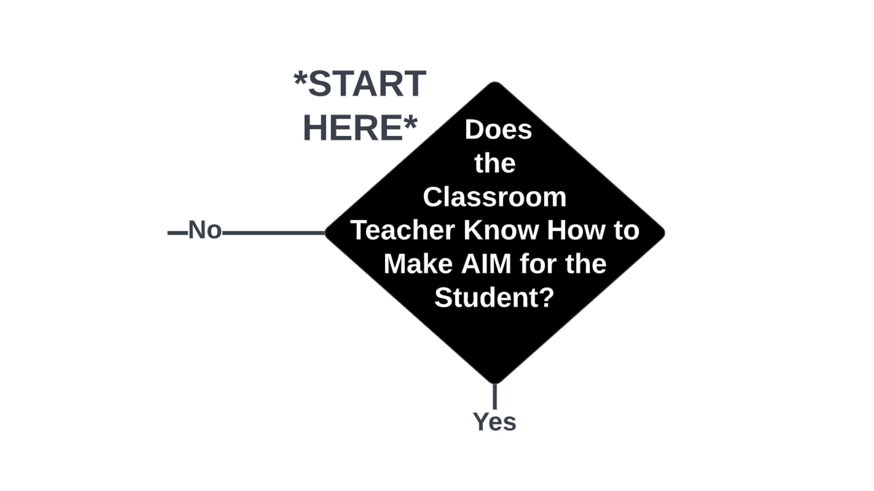
Start here. Does the Classroom teacher know how to make AIM for the student? Yes or no?
Notes:
Start here. Does the Classroom teacher know how to make AIM for the student? Yes or no?

Slide 9
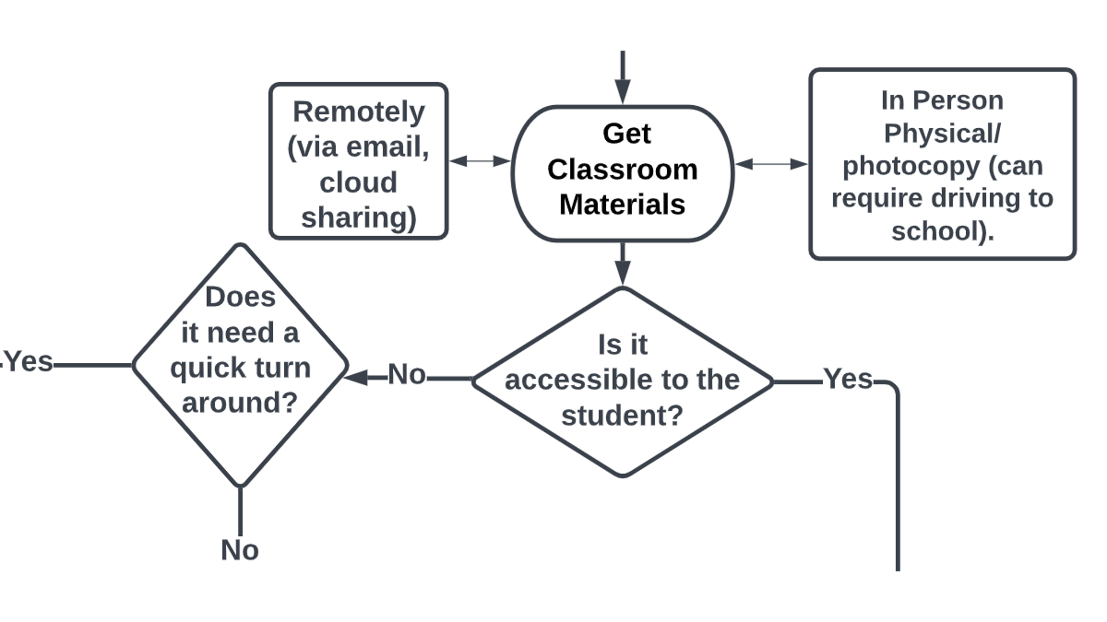
Is it accessible to student?
Notes:
The first step is go Get classroom materials. Since most TVIs are traveling teachers, they have to either pick it up in person/ physical/ photocopy which can requiring driving to school. Or get remotely via email or cloud sharing.
Is it accessible to the student? If yes move on. If no does it need a quick turn around? If yes then it will need to be adapted in house

Slide 10
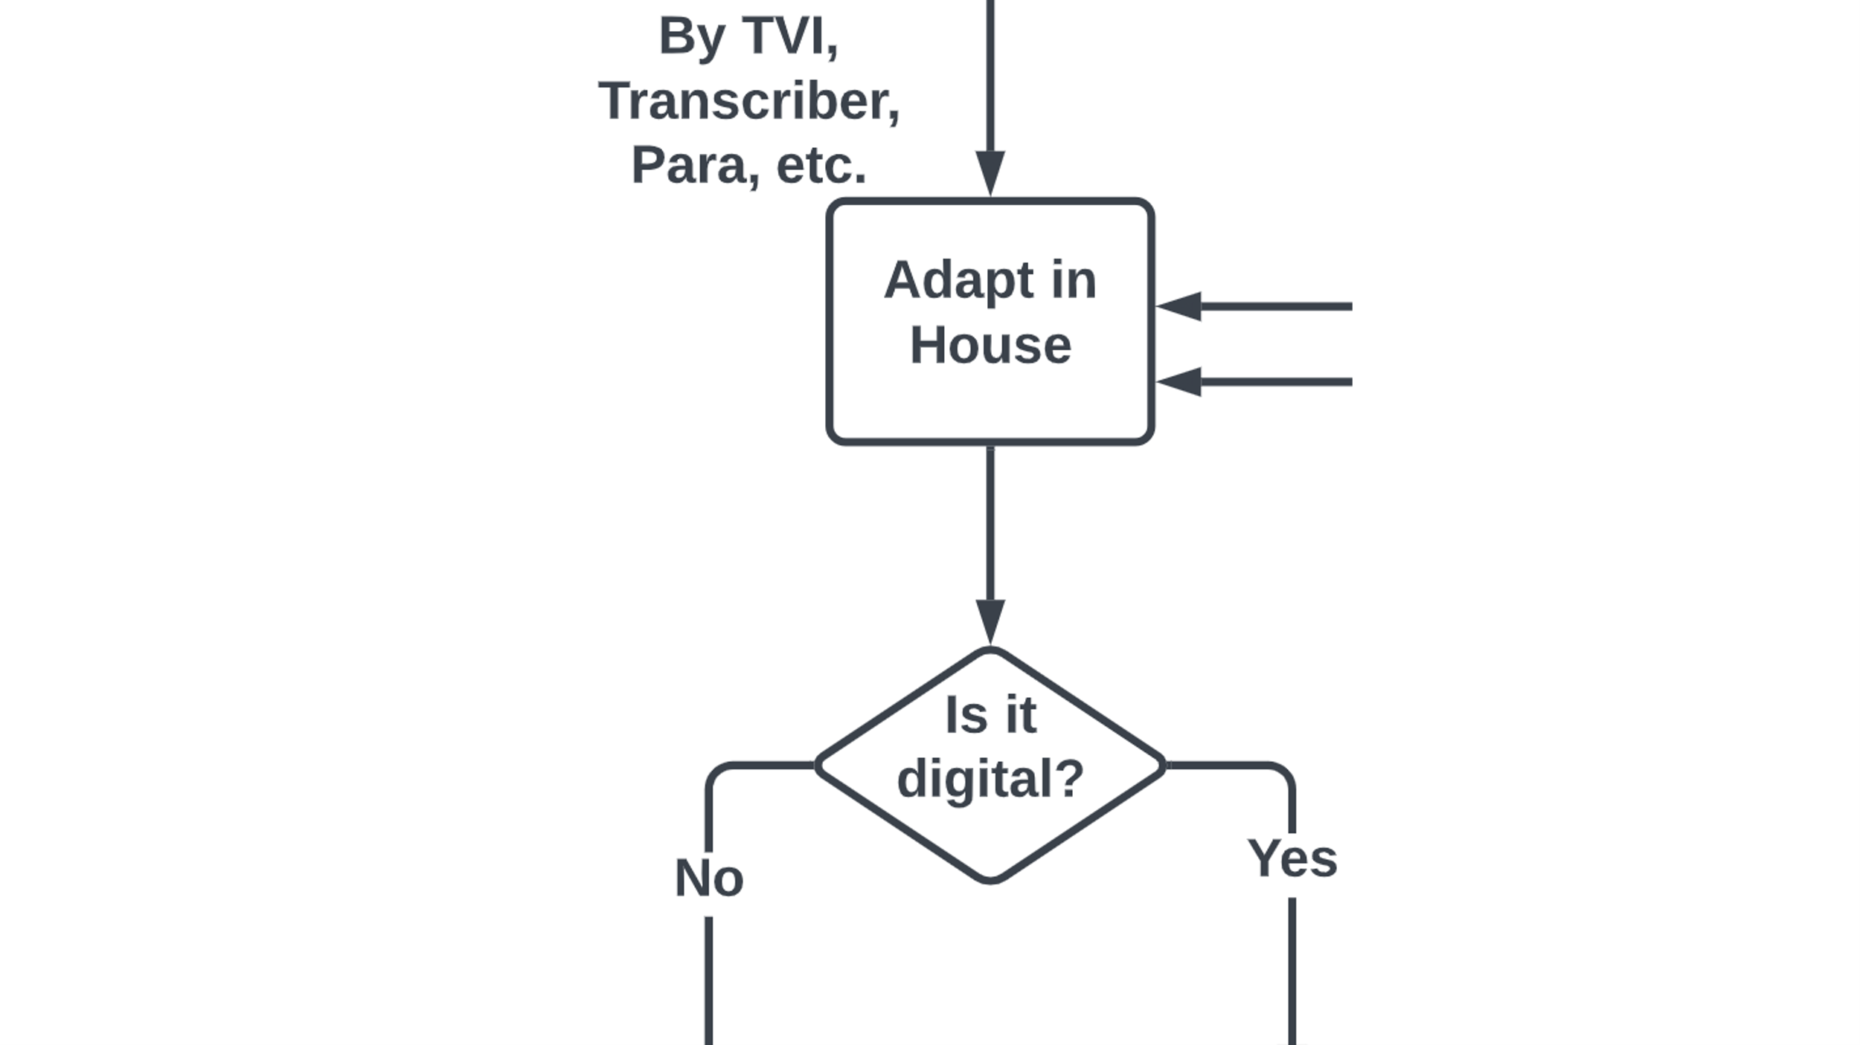
Is it digital?
Notes:
Adapt in house by TVI, transcriber, para, etc. . Is it digital? If yes move on to editing. If not [slide]

Slide 11
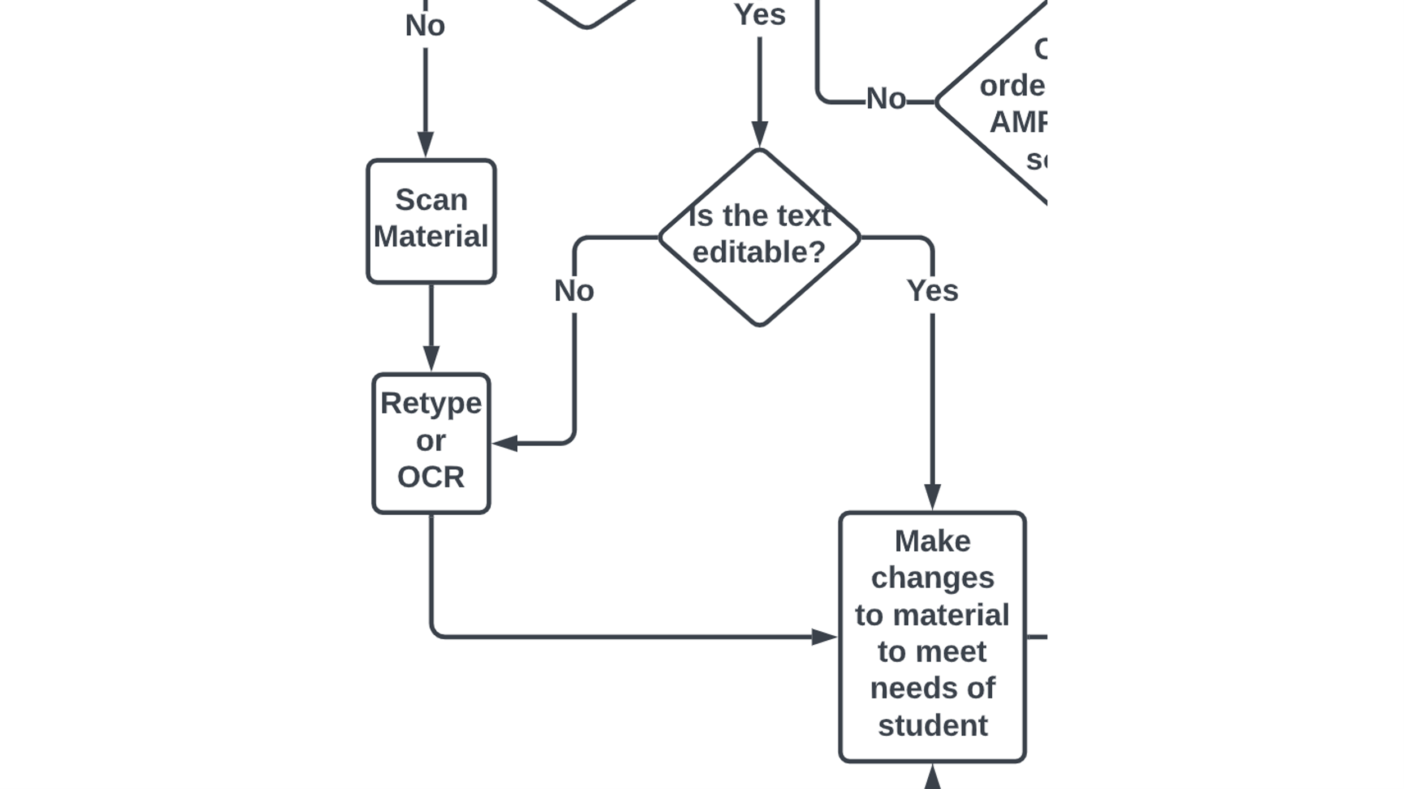
Is the text editable?
Notes:
Is the text digital? If no scan materials then retype or use OCR.
Is the text editable? Of yes make changes to materials to meet the student need.

Slide 12
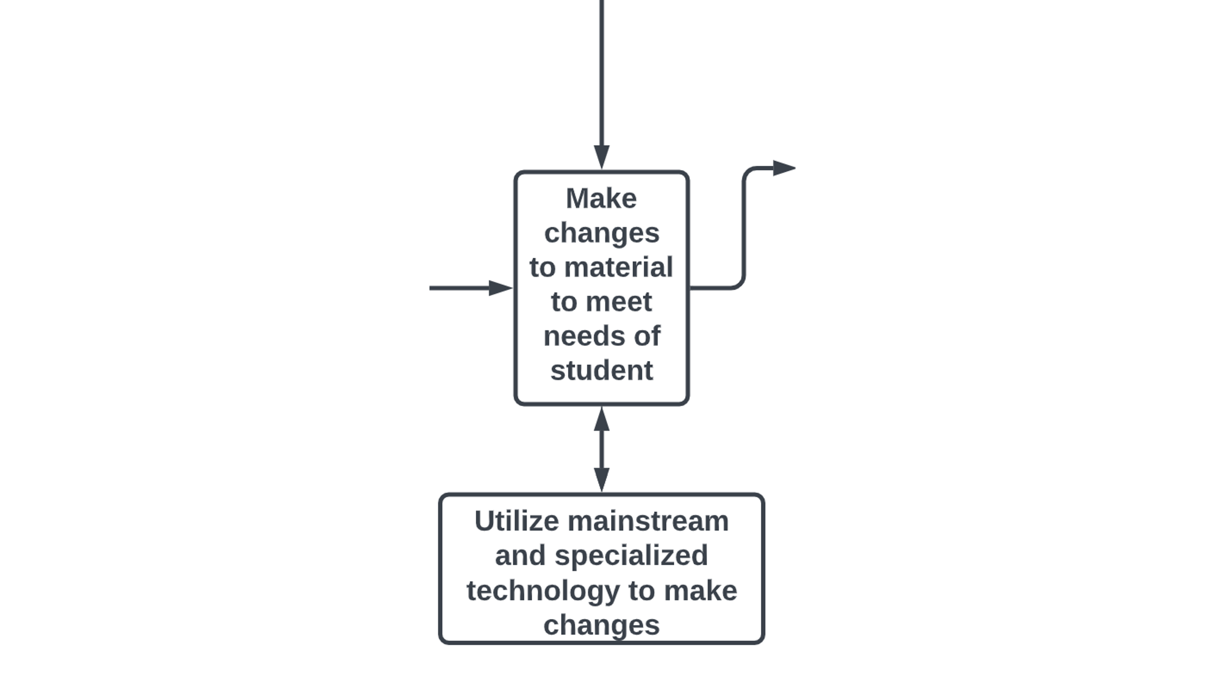
Use tech to make changes
Notes:
Iterative process, Make changes to the material to meet the needs of students. Utilize mainstream and specialized technology to make changes.

Slide 13
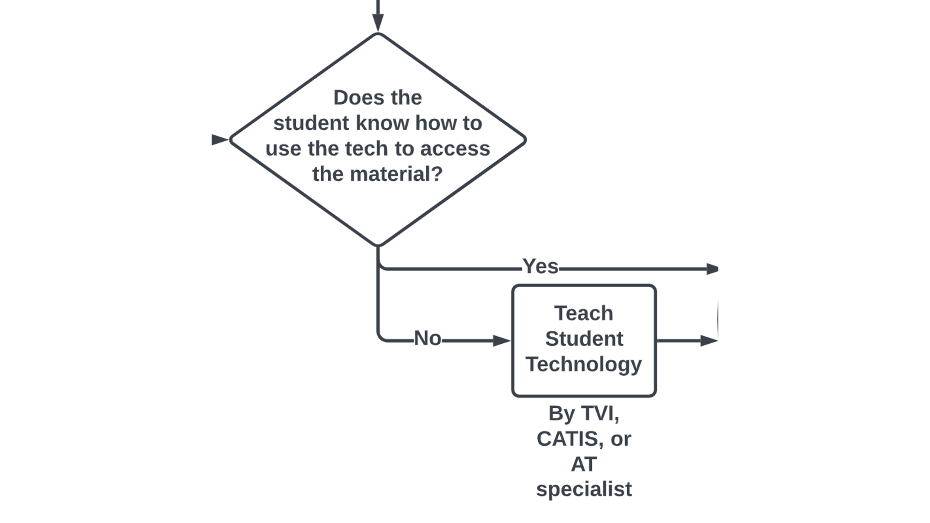
Teach tech
Notes:
does the student know how to use the tech to access the materials? If yes move on, If no, teach the student technology by TVI, CATIS, or AT specialist.

Slide 14
Student has access to material
Notes:
now let's say you have time and you can find it through an accessible media producer

Slide 15
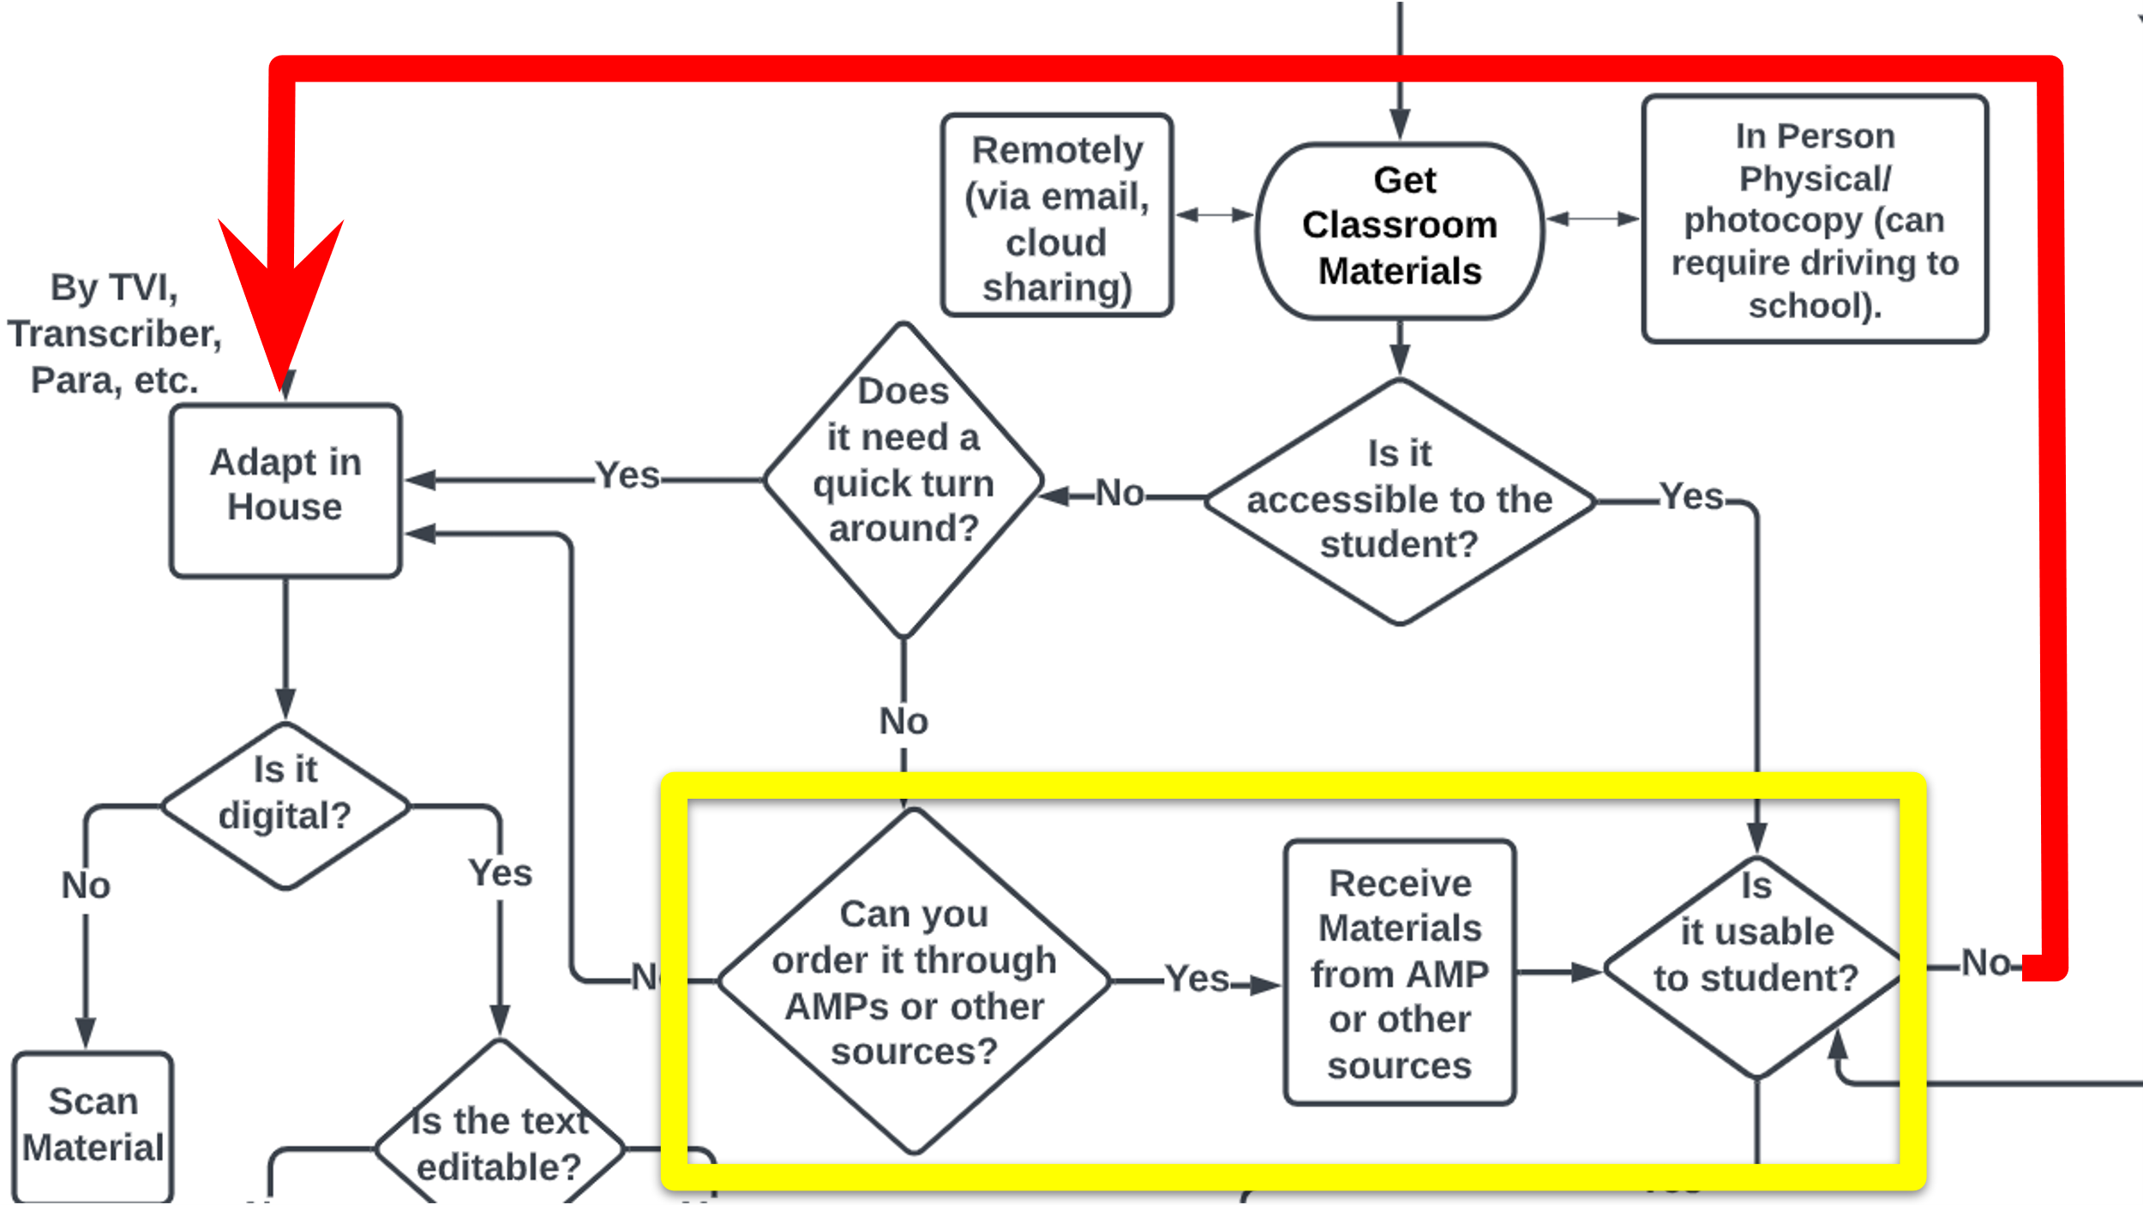
AMP process
Notes:
If you do not need a quick turn around you can search for accessible materials you can see if materials are available through an Accessible media producers AMPs which are commercial services that convert materials into student-ready formats. Federal Quota Funds to purchase through the American Printing House for the Blind (APH). Once you received the materials you have to see if it is usable for the student. If it is not, then you have to do an in house adaptation. AMPs are good for bigger projects like textbooks. But they do not cover teacher made specialized materials which is the majority of what teachers use now.
~75% teacher made digital content

Slide 16
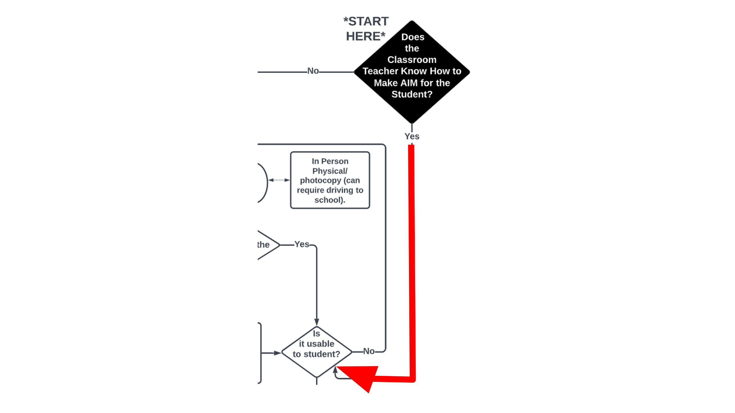
If classroom teacher knows how to make AIM
Notes:
Ok. So now let's assume the classroom teacher knows how to make digital AIM. You would go to if yes, go to is it usable to student. Then follow the decision back to is it usable to the student.
The only national empirical study addressing worksheet usage reflective of general education classrooms found that in a typical school year, elementary pupils do 1,000 worksheets (Lee, 2014). The potential amount of work that must be adapted can be overbearing on TVIs. So you TVIs have to go through this process for any of their students that need digital aim.

Slide 17
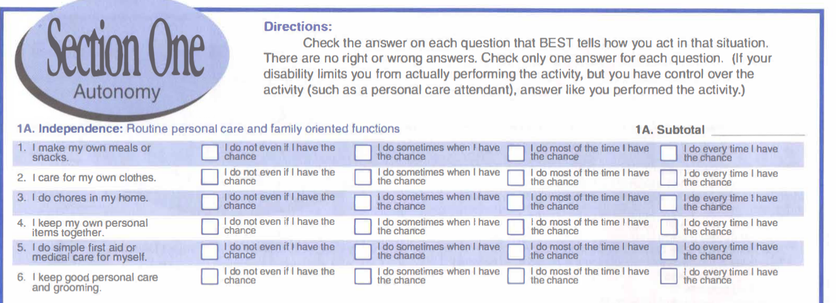
Get Copy
Notes:
So first I get a copy of the materials and I have determined it is not accessible.

Slide 18
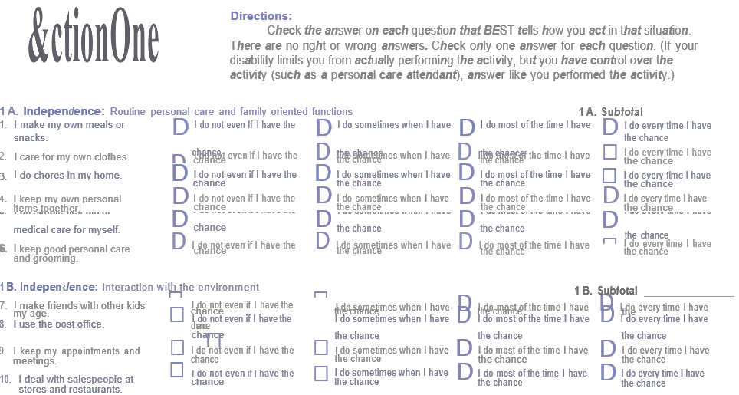
OCR
Notes:
Next I have to make the text editable. Example of using optical character recognition to make text editable. There is a lot of errors and I have to manual go through to make changes.

Slide 19
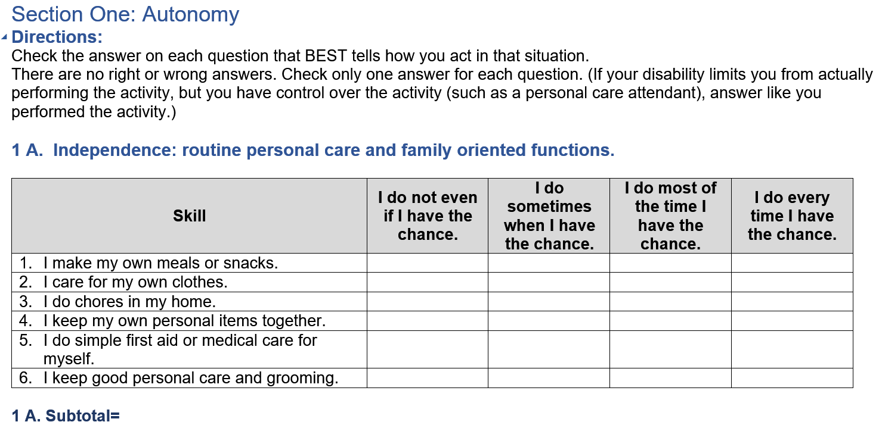
Edit
Notes:
Here is an example of the finished adapted copy.

Slide 20
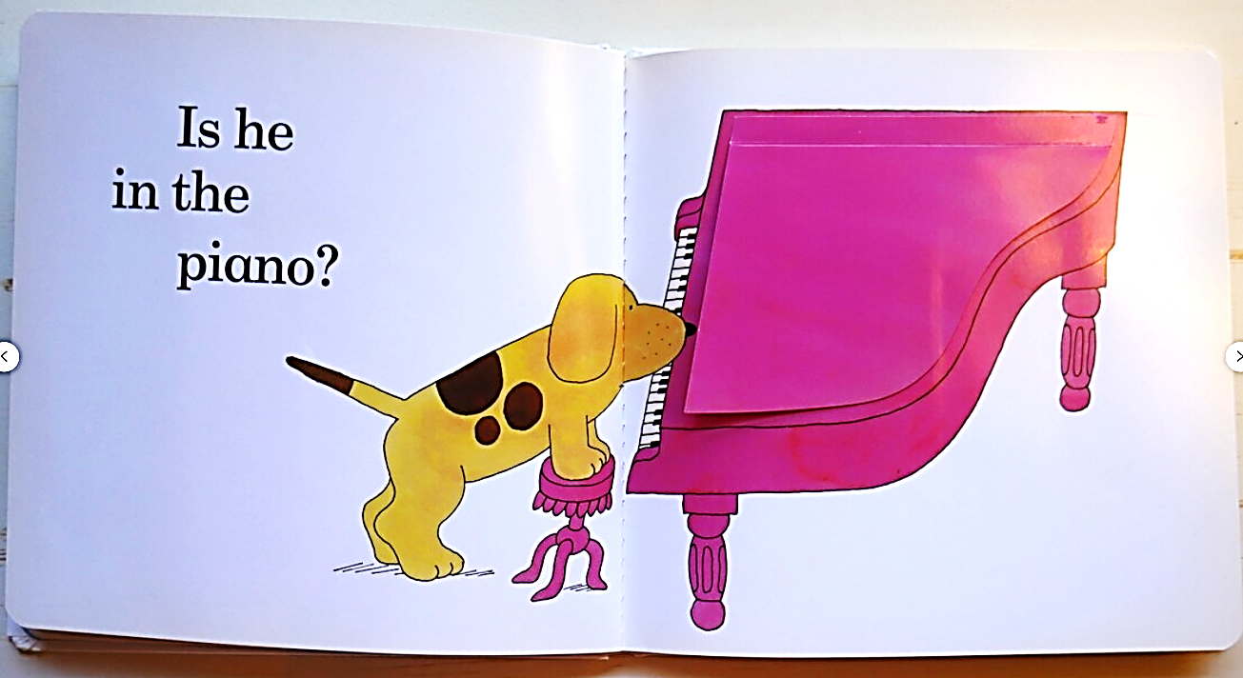
Example of electronic adapted book: Before
Notes:
Here is another example of a Hard copy book, flip pages where is spot. Students with visual impairments may have additional disabilities where they don’t have the fine motor skills to interact with books.

Slide 21
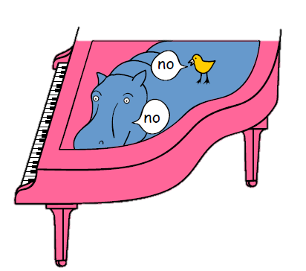
Example of electronic adapted book 2
Is he in the piano?
Notes:
So here is an example of an adapted copy that reduced the visual complexity and is a digital version where a student can use a switch.
Is he in the piano? No

Slide 22
Usable?
Original Image of Example Text
“Accessible Copy”
Notes:
What do I mean by usable? Example of the actual document I received.
On the left is the original copy. And on the right is the quote on quote accessible copy.

Slide 23
Timeline for Access to Digital AIM
Rehab Act Section 504
Education for All Handicapped Children Act
UDL
Tech: email, braille translation, embossers, CCTVs, refreshable braille display, home computers, screen readers, DAISY file, MS Word and PWPT, Kurzweil flatbed scanner
IDEA reauthorization (AT & NIMAS)
CRPD
WCAG 2.0
Tech: Braillenote, Wifi speed, Voiceover, NVDA, iPhone, built in iOS Accessibility, Google docs, video chat, social media, Youtube, Epub, Bookshare
1st school for the blind
Braille invented
APH Quota Funds
Definition for legal blindness
1st TVI prep program NLS for Blind
Prison braille program
Tech: typewriter, large print, talking book, Perkins braille writer, thermoform machine, synthesized speech, OCR
Section 508 + WCAG
National Tech Plan + UDL
Marrakesh Treaty
SDGs
ESSA
CATIS
COVID
Tech: iPads, Google Drive, Chromebooks, Zoom, AI
ADA
IDEA
Chafee Amendment
Section 508
WCAG Guidelines
Tech: Duxbury for Windows, built in accessibility, internet, Google, PDF, dictation, accessibility checkers
Notes:
I want to highlight that education for BVI has a long history. This timeline represents a brief history of key legislation and technology development for digital AIM.
Up until the 1960s some of the major advancements included….[click]
The mid-1970s built the foundational groundwork for digital accessibility policies in the U.S. The U.S., The Rehabilitation Act of 1973, Section 504, prohibits federal agencies, programs, or activities from discriminating and requires reasonable accommodation for qualified individuals with disabilities. For all students to reap the pedagogical benefits of technology, schools are obligated under Section 504 and Title II to make that technology accessible to those with disabilities (Office of Civil Rights, 2020). On November 29, 1975, the Education for All Handicapped Children Act Public Law 94-142 (EHA) provided equal access to education for children with disabilities (U.S. Department of Education, 2020). The Universal Design of Learning principles is considered one of the best practices for integrating accessibility developed by Rose (1984). These monumental laws opened the door to ensuring that students with disabilities have access to education.
The 1990s continued to build upon the 1970s legislation. These laws continue to govern how information needs to be accessible for students with visual impairments. The 1990 Americans with Disabilities Act (ADA) was the world's first comprehensive proclamation of equality for people with disabilities by prohibiting discrimination based on disability in employment, government, public accommodations, commercial facilities, transportation, and telecommunications. The Rehabilitation Act of 1973 later added Section 508 in 1998 for the accessibility of electronic and information technology for any government-funded organization. The Individuals with Disabilities Education Act (IDEA); guarantees access to a Free and Appropriate Education Public Education in the Least Restrictive Environment for every child with a disability. The Web Content Accessibility Guidelines (WCAG) guidelines, first published in 1999, have evolved with technology to become the international standard for digital accessibility (Enamorado, 2019; Paciello Group, 2020). WCAG has 12 guidelines that address four principles: perceivable, operable, understandable, and robust. WCAG guidelines include using alternative text, good contrast, resizable text, keyboard accessibility, and usage of headings.
During the early 2000s Major policies during this time included reauthorization of IDEA emphasized the need for AT and started the National Instructional Materials Accessibility Standard (NIMAS) is a technical standard used by publishers to prepare “electronic files” that are used to convert instructional materials into accessible formats. The 2008 Convention on the Rights of Persons with Disabilities (CRPD) international treaty to protect disable rights was a major global accessibility catalyst. There were now faster wifi speeds, more screen readers were made available (i.e. voiceover and NVDA), Bookshare a electronic library of accessible books was founded and students get for free, AT major braillenote taker, mainstream tech iPhone.
The 2010s showed more incorporation of accessibility through international treaties and goals such as in section 508 to include the WCAG standards, the national technology plan to include UDL. Every Student Succeeds Act (ESSA) supports the universal design of learning. The Marrakesh Treaty was adopted in 2013 which was an agreement to facilitate access to published works for people with visual impairments or other print disabilities. A new credential in the field of visual impairment for Certified Assistive Technology Instructional Specialist (CATIS) was launched in 2016 to help distinguish vision educational specialists proficient in dealing with technology with students with VI. CATIS can help with teaching students AT. However, there is a shortage and CATIS do not acquire materials. The COVID-19 pandemic brought numerous changes to students with visual impairments education, including the increased usage of digital materials. Digital instructional tools became mandatory for teachers who rarely utilized them during the 2020 COVID-19 pandemic, which closed schools globally for months.

Slide 24
Summary of Literature
Unknown number of people impacted
Long history (legal, technology)
Shortages and Unclear Responsibilities
History of low proficiency w/ tech (even with tech experts)
More info needed on theories of best practices and what is happening in the field

Slide 25
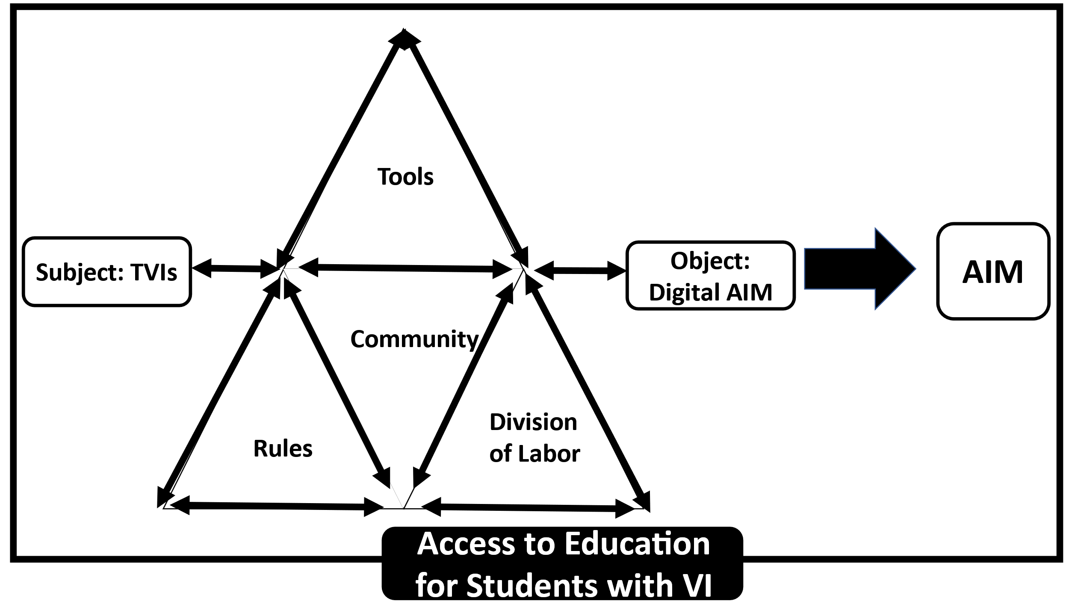
Cultural-Historical Activity Theory (CHAT)
Notes:
In order to answer my research question I needed to know more than just the tools TVIs are using. The main framework I am using is Engeström 2001 Cultural--- CHAT from social psychology. The seven components of the CHAT when combined, enable the analysis of TVIs and the digital AIM activity system as a whole. The overall outcome is having AIM, which is part of having students with visual impairments access education.
The object/objective—the digital AIM—drives a subject's activity. The subject is the individual involved in the activity, which is the TVI. Knowledge, training, background, and demographics comprise the subject. Tools can be physical or cognitive resources that are socially shared to accomplish a goal, including mainstream and assistive technology, online resources, training, and accessible material libraries. Community members share common norms and social and cultural backgrounds with that group. Members or stakeholders of the community include paraeducators, Accessible Media Producers, fellow TVI colleagues, general educators, transcribers, parents, and students. Division of Labor means shared participation in a community-determined activity and different responsibilities of the TVI. Community members can collaborate to educate visually impaired students by dividing the work. The community follows policies and accessibility best practices as rules. The norms established by a community's shared social and cultural backgrounds, including legal policies and best practice accessibility guidelines, are referred to as rules.

Slide 26
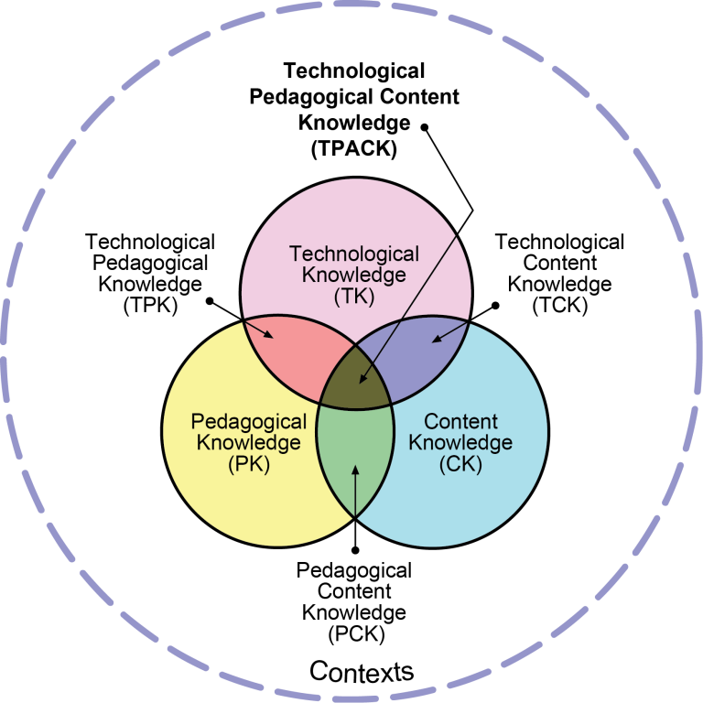
TPACK
Notes:
Since technology and digital AIM are the focus of this study, an additional framework was required to investigate technology's impact further. Technological Pedagogical Content Knowledge (TPCK), introduced by Mishra and Koehler (2006). defines the knowledge teachers need to integrate technology into their instruction while addressing the complex, varied, and situational nature of teacher knowledge. The TPACK framework three components—Technology Knowledge (TK), Pedagogy Knowledge (PK), and Content Knowledge (CK)—intersect to form this model's seven components; see Figure 4. This study integrates Mishra & Koehler 2006 and Schmidt et al., 2009 definitions of the seven TPACK components.
Content Knowledge (CK): Teachers must understand their teaching subject. Since most TVIs work in public schools, they need to understand the common and expanded core curricula.
Pedagogy Knowledge (PK): TVIs must understand how students learn meaning using formal and informal assessments to address learners' needs to teach the expanded core curriculum (ECC).
Technology Knowledge (TK): TVIs need technical knowledge to work.
Pedagogical Content Knowledge (PCK), Technological Content Knowledge (TCK), and Technological Pedagogical Knowledge (TPK) are intersections of the knowledge points where TVIs need to combine at least two types of knowledge at a time.
Technological Pedagogical Content Knowledge (TPACK): The central intersection of all three knowledge is teachers who are effective with technology. TVIs need to utilize technology constructively to represent concepts, teach concepts, and address learners' needs.
Reproduced by permission of the publisher, © 2012 by tpack.org

Slide 27
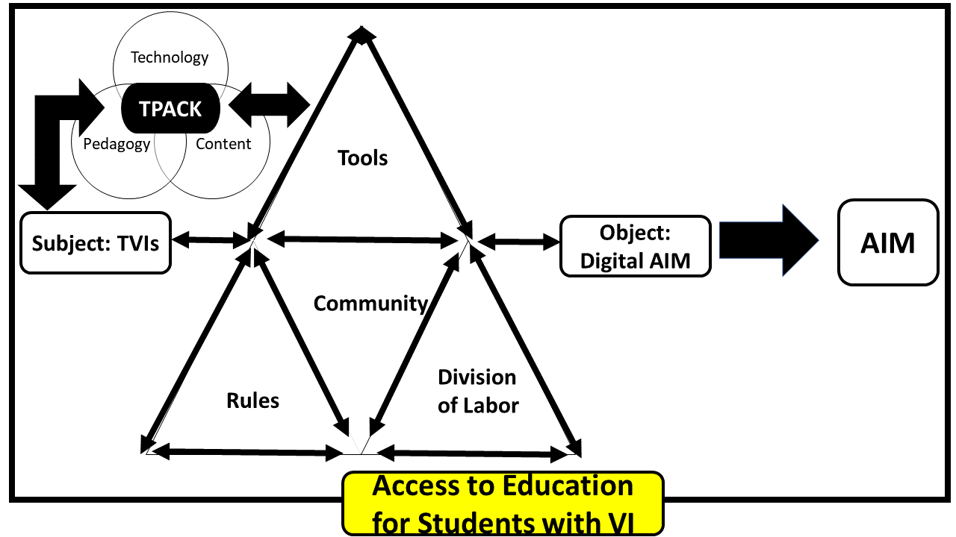
CHAT + TPACK Framework
Notes:
On this slide I have a visual of how the TPACK in integrated with the Tools and Subject portion of the CHAT framework. I combined the CHAT and TPACK frameworks, this research can examine how TVIs integrate technology to acquire AIM. The CHAT framework provides a foundation to understand how technology and other resources are used to acquire materials, while the TPACK theory adds a layer of depth by providing context for understanding how TVIs’ use of technology can be adapted to meet the specific needs of students

Slide 28
Study Design
Survey
General: Demographics, caseload, tech proficiency
Presentation Simulation
Worksheet Simulation
Notes:
The survey was administered through Qualtrics, and data were collected from May 15th 2023 until September 15, 2023 through an online survey platform. The survey tool was tested for accessibility and usability using a combination of recent TVIs who changed jobs and worked as itinerant and schools for the blind, screen reader users, low-vision tool users, and digital accessibility experts.
The first section gather information about demographics, caseload information, and self rated tech proficiency
The two simulation/ application portion or skill test collected data on how accurately TVIs applied the best practice guidelines. TVIs had the same inaccessible documents to control for multiple time factors. A rubric based on the two major guidelines driving current accessibility practices, WCAG, and UDL, scored TVIs' application skills. The scores from the application documents and self-reported proficiencies were compared to see if any relationship existed between TVI’s technology proficiency and either time or accuracy.

Slide 29
Self-rated Proficiency Examples
10 Statements in each category (50 total)
Category 1: Foundations of AT, collaboration, & development
Category 2: Use of Assistive Technology
Category 3: Use of Mainstream Technology
Category 4: Assessment, instructional strategies, & planning
Category 5: Access to information
Notes:
An abbreviated list of competencies based primarily on Smith et al. (2009) AT competencies for TVIs. Schmidt et al. (2009) TPACK measurements and Kelly & Kapperman’s (2018) skills list was compared and integrated based on similarities. Approximately 200 statements will be narrowed down to 50 final questions and divided into five categories. All authors' permission has been obtained to utilize and adapt the questionnaires and lists.
Category 1: Foundations of assistive technology, collaboration, and development
Laws regarding copyright and licensing of software, including shareware and freeware.
Category 2: Use of Assistive Technology
Use built-in accessibility features on smart devices (i.e. gestures for screen readers, screen magnification, and switch access)
Category 3: Use of Mainstream Technology
Use Microsoft programs (i.e., Word, PowerPoint, and Excel)
Category 4: Assistive technology assessment, instructional strategies, and planning
Plan for AT instruction that is comprehensive, effective, relevant, and focused on the needs of the individual student (e.g., write AT goals and objectives in lesson plans, record data, and measure progress).
Category 5: Access to information
Teach the students how to use
No exposure (0)— Novice (.25pt) — Basic (.5pt)— Proficient (.75pt)— Advance (1pt)

Slide 30
Scoring Guide for Tech Proficiency
Total points out of 50pts
No experience (25% or less) = Less than 12.5 points
Novice (26% - 50%) = 13-25 points
Basic (51%-75%) = 25.5 -37.5 points
Proficient (76%-99%) = 38 - 49.5 points
Advance (100%) = 50 points

Slide 31
Example of Simulations
Presentation
Worksheet
Notes:
I purposefully made these scenarios a little difficult.
Presentation scenario: Imagine that you have a student on your caseload who requires the use of a screen magnifier and screen reader to access educational materials. The classroom teacher emailed you a presentation inaccessible for this student and requested that you make it accessible before the next class, as they will be doing a special butterfly activity. Your task is to modify the presentation to an accessible format using either Microsoft PowerPoint presentation OR Google Slides so that the student can participate in class activities.
WKST scenario: A student relies on a screen magnifier and screen reader to access class materials. You have asked the classroom teacher to send electronic copies of the worksheet so you can adapt it remotely. The classroom teacher has just sent you a secure PDF copy of a worksheet that is inaccessible to this student. Your job is to adapt the worksheet into an accessible word-processing format using either Microsoft Word or Google Docs. The teacher has emphasized the urgency of this task and requested that you have the modified worksheet ready by the end of the day, as the student needs it for their homework assignment.

Slide 32
Rubric Example
10 categories (total out of 50 points)
1 point: Very Poor Quality (25% or less Correct)
2 points: Poor Quality (26%-50% Correct)
3 points: Low Quality (51%-75% Correct)
4 points: Medium Quality (76%-99% Correct)
5 points: High Quality (100% Correct)
Notes:
The rubrics requirements were adapted from the National Center on Disability and Access to Education and Web AIM cheat sheets based on Microsoft Document Best Practices and the WCAG 2.1 guidelines.
Text alternatives: Include alt text with all visuals.
Font Type & Size: Use 18pt or larger. Select familiar, simple fonts such as Arial or Calibri.
Spacing: Line spacing at least 1.5 times the font size. Avoid unnecessary blank lines.
Title: Give every slide a unique title.
Meaningful links: Add meaningful, unique hyperlink text.
Color: Avoid using color alone to communicate.
Contrast: Use sufficient contrast for text and background colors (opposite ends of the color spectrum).
List and columns: Use built-in list or column formats (i.e., numbers or bullets lists or column layout).
Accurate Text
Correct Reading Order

Slide 33
Summary of Participants
Total Participants: 117
Most participants
age 35-44, white, female
Teach K-12
Itinerants
Work for school district
Average Years in Field: 8.47 years
Caseload average: 20.45 students
80% at least half their students need digital AIM
Notes:
Data for this study was collected from May 15th, 2023 until September 15th, 2023. In order to qualify for the study, participants had to meet the following five criteria: (1) demonstrate they understand the survey terminology by passing three questions; (2) currently be working as a TVI either full or part time; (3) teach K-12 which includes students up to age 22; (4) teach in the United States or one of the Territories; (5) work with students that need digital AIM.
More than half (53%) reported that either all of their students or the majority of them require these resources, indicating a substantial need for comprehensive accessibility support. Additionally, 27% mentioned that about half of their students need digital accessible materials.

Slide 34
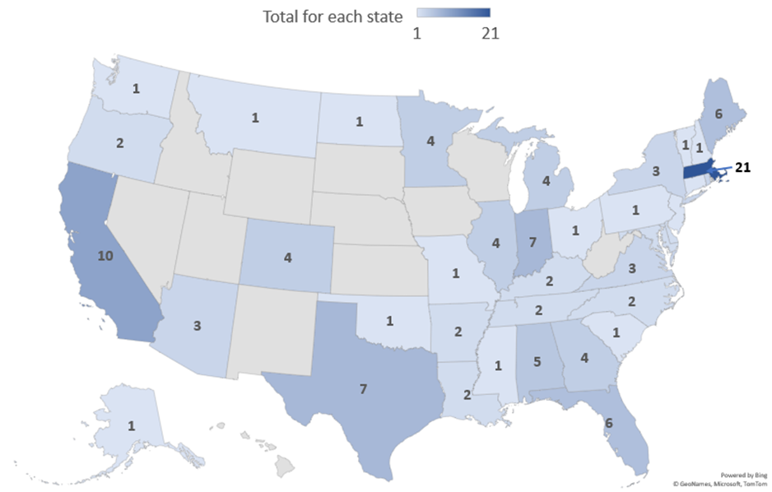
States Represented
Notes:
Note. The total number of United States’ states (including Washington DC) and 5 major territories represented is 40 which equates to roughly 71% representation across the states plus territories. Missing from the map is the American Soma (n=5). The top states represented were Massachusetts (n=21), California (n=10), Indiana (n=7), Texas (n=7), Florida (n=6), and Maine (n=6). There was n=8 participants responded that they teach in more than one state.

Slide 35
Who is designated person?
Designated Person | Gather | Order | Adapt | Deliver | Teach
No designated individual | 5 | 6 | 5 | 3 | 2
TVI* | 57 | 57 | 61 | 62 | 69
Transcriber/ braillist | 19 | 12 | 27 | 11 | 4
Alternative media specialist | 14 | 14 | 12 | 12 | 11
GenEd Teacher | 32 | 10 | 18 | 27 | 13
SPED Teacher | 35 | 17 | 23 | 30 | 21
n/a | n/a | n/a | n/a | n/a | CATIS 13
Notes:
Here is the community summary of results for who is designated person responsible for the major steps in acquiring digital AIM: gather, order, adapt, deliver, and teach. This summary table showing the top selected options. I want to bring your attention to the *TVI row which had the highest amount for each category.

Slide 36
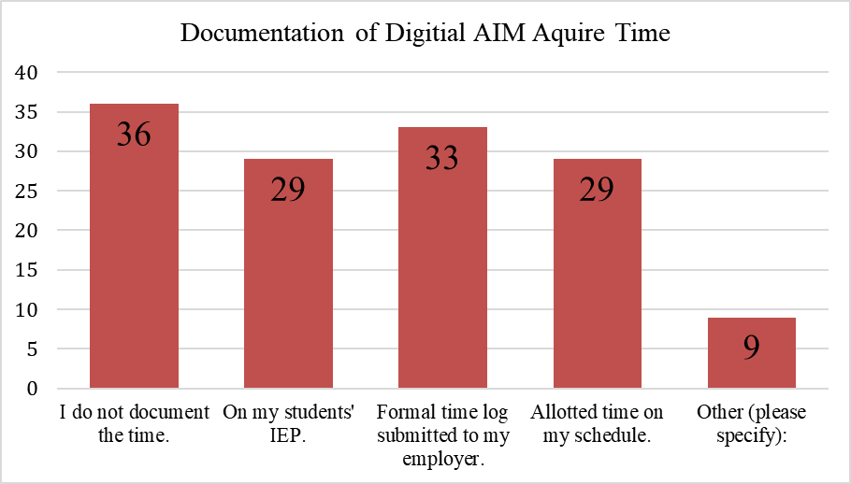
How is Time Documented?
Notes:
Division of Labor Results
Note: N=112 Participants could select more than one, so the total percentage is more than 100%. If participants selected “I do not document the time” it was mutually exclusive.
Participants were asked how they document the time it takes to acquire digital materials for their? This includes all the steps involved in getting materials from the classroom teacher to the student so that the student can access and use the materials with or without assistive technology, including obtaining, curating, creating, adapting, and disseminating. The highest response was no document of time at 32%, followed by submitting a formal time log to their employer at 29%, and on the student’s IEP and allotted time on schedule both had 26%.

Slide 37
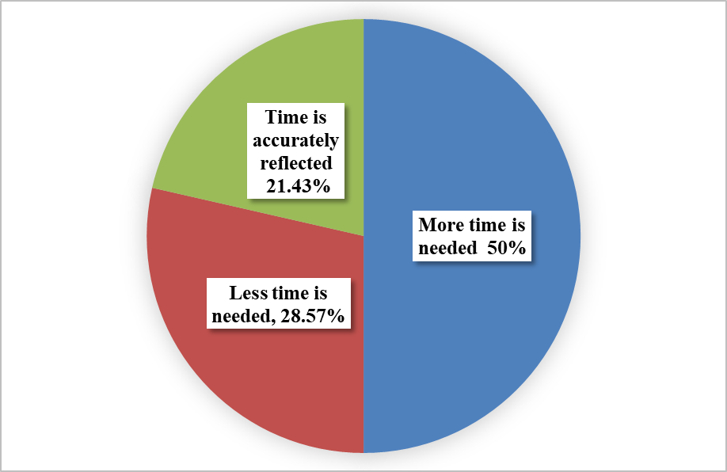
Acquired Time Reflected on IEP
Notes:
Out of the 29 participants who indicated that their acquisition time was documented on their students' Individualized Education Plans (IEPs), the most common section where they recorded their hours was the "consult/indirect hours," with a majority of respondents at 66%. The next largest area was "accommodation" section (38%) and "supplementary materials/aid" following closely (31%). Of the 29 participants, 28 shared how they would describe the appropriateness of the time. Only 21.43% of participants believe the time is accurately reflected, 28.57% think they need less tim, and half of the respondents indicated that more time is needed than is documented on their students IEP.

Slide 38
Types of Materials
Theme | Break down
Printed Materials | Worksheets 42% teacher-made materials 19%
Books | Novels 64% Textbooks 36%
Digital documents | PDFs 22% PowerPoint 20%
Core Curriculum | Math 38%
Visuals | Maps 29%
Notes:
Participants were asked to give examples of materials they commonly have to aquire. The written responses were broken down into individual line items for any that included more than one item in their response. The five prominent themes/ categories that emerged from the responses regarding the types of learning materials adapted or converted into digital accessible instructional materials (AIM) are as follows:
Printed Materials: The most prevalent theme that emerged was printed materials encompassing worksheets, workbooks, and handouts occuring in almost a quarter of responses (24.9%). Worksheets were the most frequently listed, accounting for 42% of the printed materials category, followed by teacher-made materials, comprising 19%.
Books. Books were the second largest occurring theme in 18% of responses. This category included recreational books and assigned literature which was the majority in the book category (64%). Textbooks make up 36% of the book category.
Digital documents: Digital documents emerged as the third most prevalent category, accounting for 12% of responses. This category included various types of digital documents, such as Microsoft Word Documents, Google Docs, PDFs, PowerPoints, and Google Slides. PDFs constituted 22% of this category, closely followed by PowerPoint, making up 20%.
Core Curriculum subjects: The fourth most frequently mentioned area, reported by 10% of participants, was core curriculum subjects. Math made up 38% of the subjects mentioned followed by science which made up 23% .
Visuals: The fifth most common category involved visuals (8%), which included elements like charts, diagrams, graphs, maps, pictures, and images. Maps, in particular, represented nearly a third of the visual category (29%).

Slide 39
Barriers
Lack of time during workday
Obtaining work from teachers
Inefficient process
Notes:
Out of the 108 participants who provided responses, all of them reported encountering at least one barrier when trying to acquire digital AIM. The primary barriers were similar: lack of time during the workday (57.04%) and challenges in obtaining work/materials from teachers (56.48%). Technology related barriers (lack of tools, training, and support) were next most common at 48%.
The qualitative data provided revealed one major theme which was inefficient process such as “State AIM ordering process is not digital it is paper based faxing”; “The actual material I need not being available and needing to check multiple locations before determining I will need to create the version myself. Time-consuming and not always efficient; “Schools purchase of inaccessible platforms, no input in this process.”

Slide 40
Summary of Tech Pro. Results
Highest Areas
Teaching students to increase access to writing
Using Google-based products
Lowest Areas
The history of developing AT devices and software
Applying concepts of the WCAG
Notes:
Highest Areas
Teaching students to increase access to writing (4.06).
Using Google-based products (2.04)
Lowest Areas
The history of developing assistive technology (AT) devices and software for individuals with visual impairments. (1.01)
Applying concepts of the Web Content Accessibility Guidelines (WCAG) related to individuals with visual impairments. (5.01)

Slide 41
Overall Tech Pro Score Categories
Category | n | %
No Experience (0-12.9pt) | 0 | 0.00%
Novice (13-25.49pt) | 18 | 16.82%
Basic (25.5-37.9pt) | 63 | 58.88%
Proficient (38-49.9pt) | 25 | 23.36%
Advance (50pt) | 1 | 0.93%
Notes:
N=107. Respondents had an average of 33.24 for the score putting thing in the “Basic” category. The basic category (58.88%).

Slide 42
Average Rubric Score
Presentation
28.45 points = Low quality (51%-75%)
Worksheet
33 points =Low quality (51%-75%)
Notes:
Overall, respondents did better with adapting a worksheet than a presentation with the average scores being 33 for worksheets and 28.45 for presentations. Presentation the highest scoring area was the accuracy of words. Worksheet the highest scoring area was font type. Meaningful links scored the lowest in both the presentation and worksheet simulations.
25 participants chose to continue to the simulation sections. 20 gradable
Very Poor quality (25% or less) = Less than 12.5 points
Poor quality (26% - 50%) = 13-25 points
Low quality (51%-75%) = 25.5 -37.5 points
Medium quality (76%-99%) = 38 - 49.5 points
High quality (100%) = 50 points

Slide 43
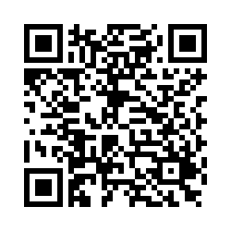
Sample Survey
https://t.ly/TVIAim
Notes:
Alternative URL: https://tinyurl.com/TVIAim
Rate your tech proficiency
No exposure: I've had no exposure to this topic or skill.
Novice: I am inexperienced or just started learning about this topic or skill.
Basic: I know some of the fundamentals about this topic or skill.
Proficient: I know the fundamentals of this topic or skill.
Advanced: I feel confident that I could teach others about this topic or skill.
You will then receive a score.
You can preview the two simulations.
Spend 10-15 minutes

Slide 44
Share
How long do you predict?
What tools would you use?
What would be the quality?
Notes:
Average time predicted: 40.75 min (Presentation); 37.63 (WKST)
Reported time: 23.90 (Presentation); 29.84 (WKST)
Self-reported Quality: Medium-It's okay, but I know I made some errors
Most used application itself (i.e. MS PWPT, Google Slides). One person used accessibility checker.
Grackle; Built in MS

Slide 45
Wrap Up
Increase the need and usage of digital AIM
TVIs directly involved in acquiring digital AIM
Gaps in the literature
Mixed methods research
Build awareness
Notes:
There is an ever-increasing prevalence of digital materials. Teachers of students with visual impairments (TVIs) are directly involved in the complicated process of acquiring digital accessible materials for K-12 students with visual impairments. Accessible materials are necessary for students to access their curriculum. Despite national initiatives, policy committees, and guidelines students and teachers are running into barriers to getting accessible materials. Without equitable access, students who are blind and visually impaired cannot access literacy skills. While TVIs are one of the main advocates, research has shown they are also one of the main gatekeepers. My research has explored TVI’s technological proficiency, application of digital accessibility best practices, and how it relates to acquiring digital AIM. This research has employ transdisciplinary mixed method approaches in conjunction with the Cultural-Historical Activity Theory (CHAT) and Technological Pedagogical and Content Knowledge (TPACK) frameworks. A surveys and skills tests was used to collect and analyze quantitative and qualitative data for this study. The findings of this study will contribute to the body of knowledge required to raise awareness of digital AIM.

Slide 46
Questions?

Slide 47
WCAG Guidelines and Examples
Guideline and Principle | Example
1.0 Perceivable | Principle; available to senses (sight, hearing, touch)
1.1 Text Alternative | Using text to describe images
1.2 Time- based media | Using live or pre-recorded captions
1.3 Adaptable | Can be reoriented
1.4 Distinguishable | Uses high contrast text that is reflowable
2.0 Operable | Principle: user can navigate content
2.1 Keyboard Accessible | Using keyboard commands to access content
2.2 Enough Time | Ability to pause or stop
2.3 Seizures and Physical Reactions | Limited number of flashes
2.4 Navigable | Utilizes elements on the page to move around
2.5 Input Modalities | Various types to input can be used beyond keyboard
3.0 Understandable | Principle: user can easily comprehend
3.1 Readable | Text content can be read and understand
3.2 Predictable | Webpages appear and operate in predictable ways
3.3 Input Assistance | Automatically detects errors
4.0 Robust | Principle; can work with a wide range of technology
4.1 Compatible | Content works with various assistive technology
Notes:
Note. The table is a summary of the 2018 Web Content Accessibility Guidelines (WCAG) 2.1 https://www.w3.org/TR/WCAG21/

Slide 48
Rubric Score Category
Very Poor quality (25% or less) = Less than 12.5 points
Poor quality (26% - 50%) = 13-25 points
Low quality (51%-75%) = 25.5 -37.5 points
Medium quality (76%-99%) = 38 - 49.5 points
High quality (100%) = 50 points

